Slide 1
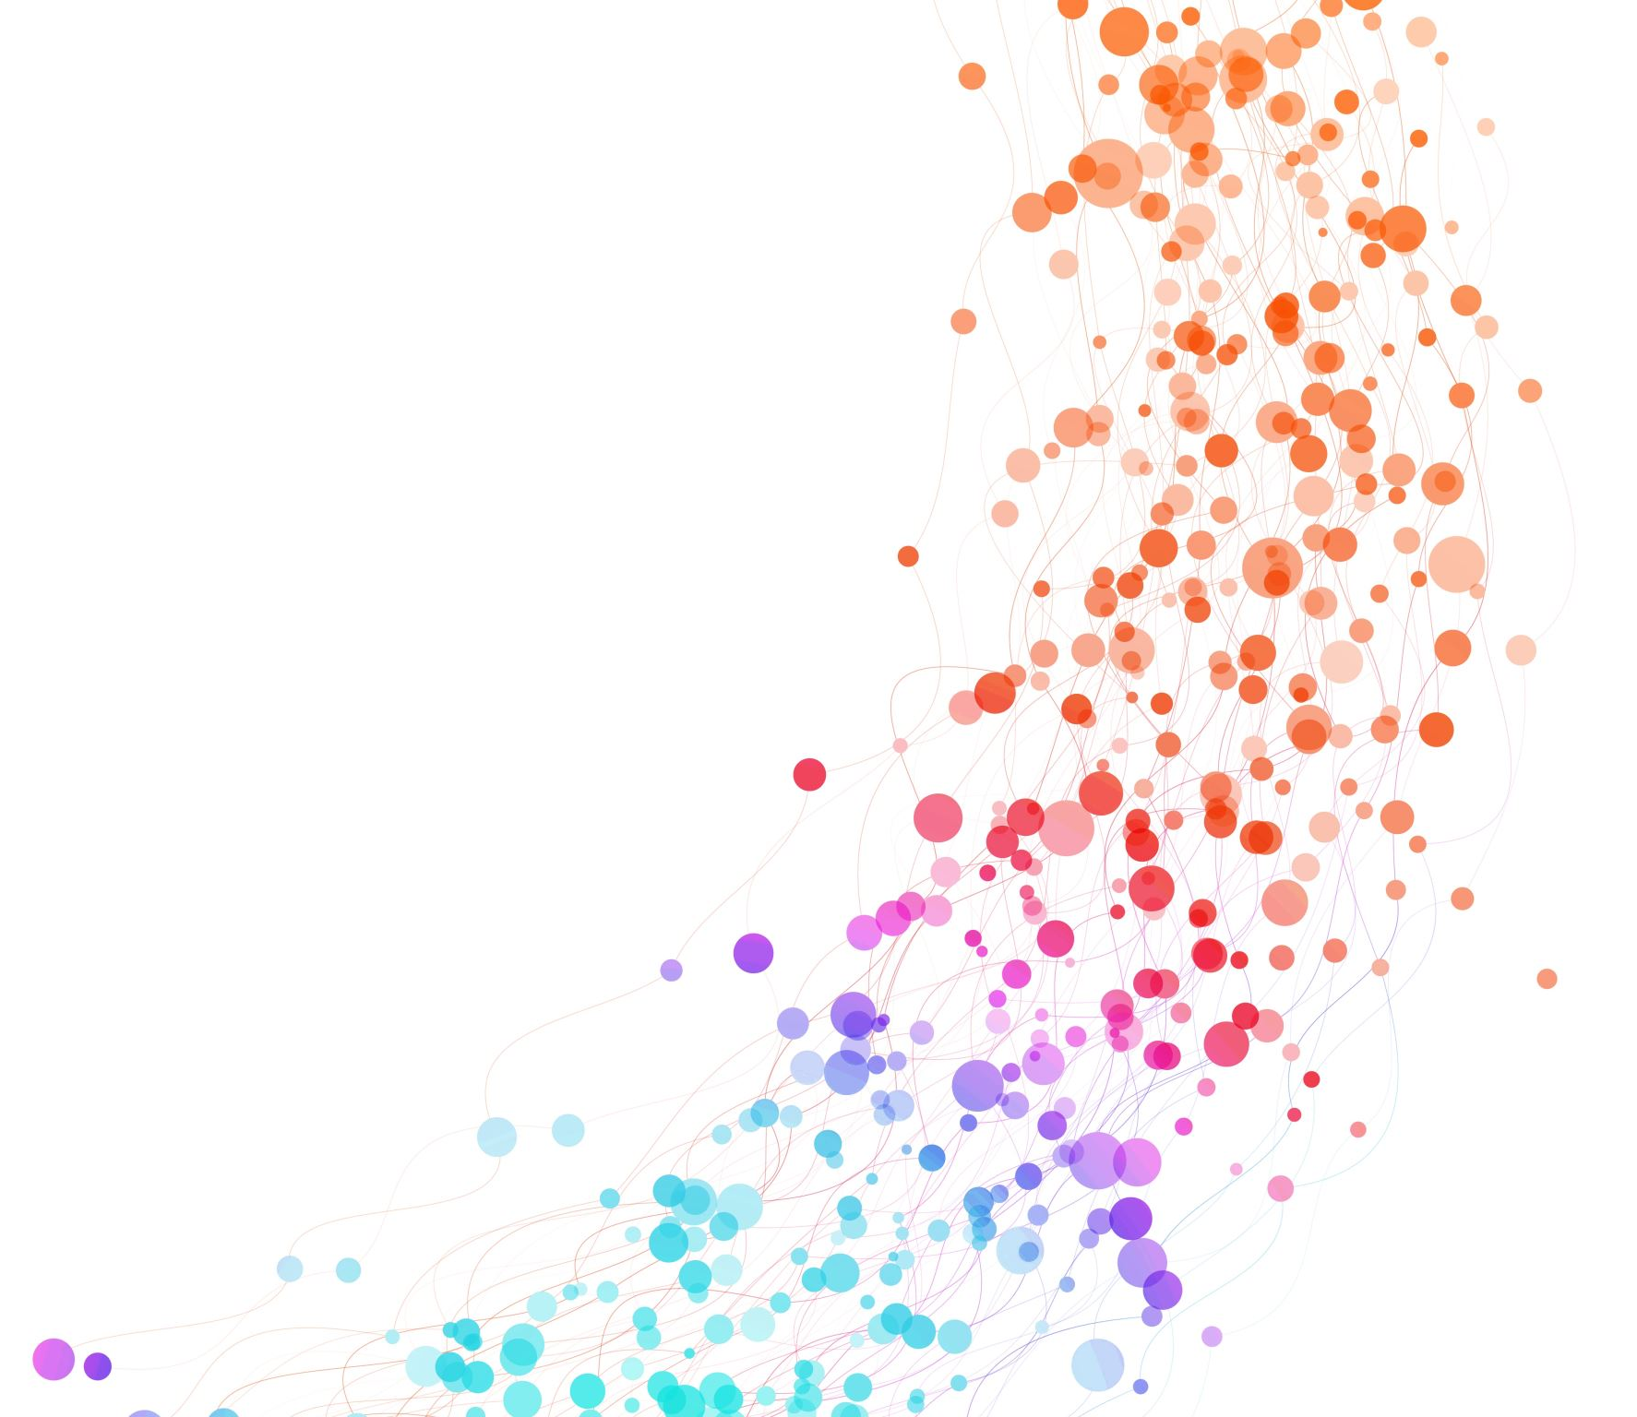
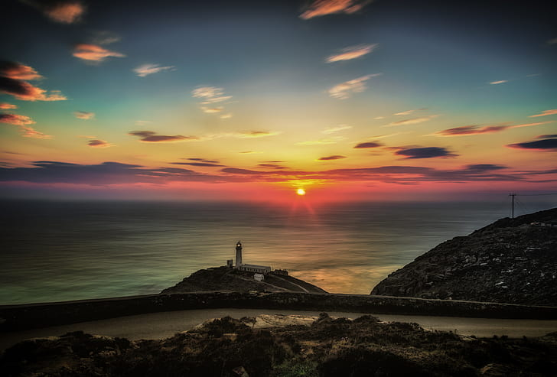
……And on the seventh day there was rest.

Slide 2
Niksen (Dutch word for doing nothing)
For a little while, may you have no goals,
Just be.
For a little while, may you have nothing to do,
Just be.
For a little while, may you let your mind wander,
Just be.
For a little while, may you watch the sky and the trees,
Just be.
For a little while may you lose all sense of time,
Just be.
For a little time, may there be no words,
Just be……...With Me.

Slide 3
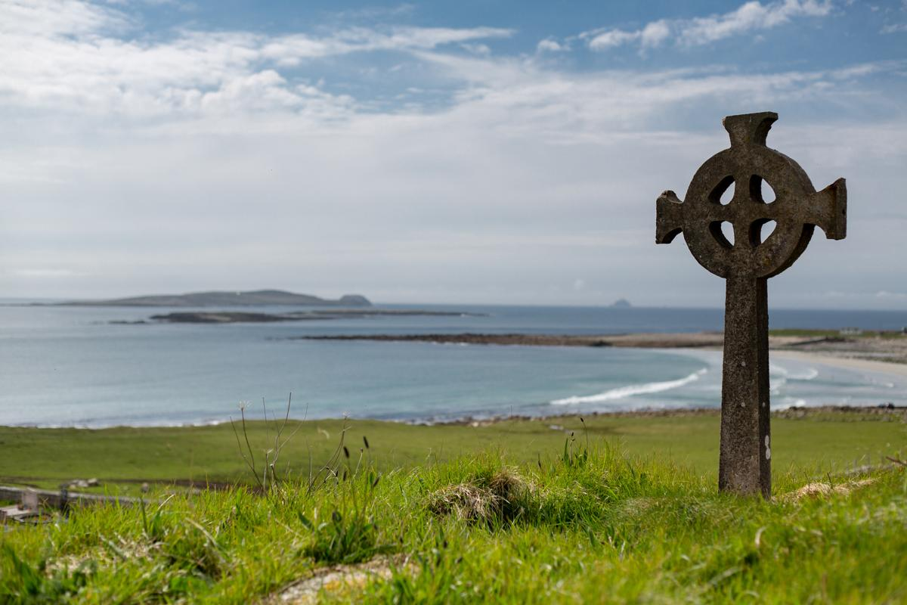
Music: ‘A Gaelic Blessing’ John Rutter
Deep peace of the running wave to you
Deep peace of the flowing air to you
Deep peace of the quiet earth to you
Deep peace of the shining stars to you
Deep peace of the gentle night to you
Moon and stars pour their healing light on you
Deep peace of Christ, of Christ
The light of the world to you
Deep peace of Christ to you

Slide 4
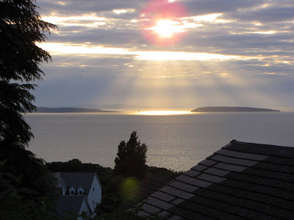
Meditation
Jesus breathes peace on his friends at the end of the day.
May the peace of God settle in our hearts and bring us to rest in the Spirit.
Spirit of God, breathe through the challenges of this day
Let Your peace bring order to our hearts and minds
Remind us that we are always safe in your presence

Slide 5
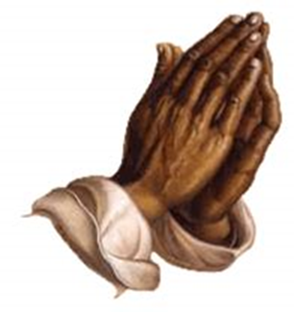
Choral Prayer (Say together)
Save us Lord, while we are awake
Protect us while we sleep
That we may keep watch with Christ
And rest with him in peace
At last, all powerful Master
You give leave for your servant
To go in peace according to Your promise
For mine eyes have seen Your salvation
Which You prepared for all nations
The light to enlighten the gentiles
And give glory to Your people Israel

Slide 6
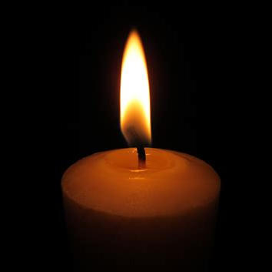
‘The Lord Bless You and Keep You’ John Rutter
The Lord bless you and keep you.
The Lord make His face to shine upon you and be gracious unto you The Lord lift up the light of His countenance upon you And give you peace. Amen.

