Slide 1

Spring term 2026: CAFOD update
Susan Kambalu
December 2025

Slide 2

Jubilee Legacy
Notes:
In making the Jubilee pledge, we promised to live out Catholic Social Teaching. It’s not too late to make your pledge and mark that on the Pledge Map! There are many ways you can live out the Jubilee Pledge and CST with CAFOD. Ideas can be found at cafod.org.uk/jubilee-schools/jubilee-pledge

Slide 3




Make the pledge
Mark the Jubilee Year 2025 as signs of hope: join over a thousand schools in making the Jubilee Pledge to live out CST and build a better world. It’s easy to do – you are already living out CST! The Jubilee Pledge is not just for 2025 but is a whole school, long term commitment…it’s never too late to make the Jubilee Pledge!
Simply:
Download the Pledge poster Education_Jubilee_PledgePoster.pdf
Decide together how your school will live out the pledge and add a few lines to the poster (you may want to simply mirror your mission statement)
Choose your school from a drop down list to add yourselves to the pledge map and receive your pledge certificate: Jubilee Pledge map for schools (this takes 2 minutes!)
Live out your pledge!
Resources:
Jubilee pledge for schools – find all Jubilee Pledge resources/info here
Jubilee Pledge online map for schools - use the drop-down menu to select your school, which will then be plotted on the map. A Jubilee Pledge Certificate will then be sent out automatically – great evidence for the CSI file too!
Education_Jubilee_CPDPledgeDay.pptx – read this for a brief but more detailed explanation of why and how to make the Jubilee Pledge
Notes:
Mark the Jubilee Year 2025 as signs of hope: join over a thousand schools in making the Jubilee Pledge to live out CST and build a better world. It’s easy to do – you are already living out CST! The Jubilee Pledge is not just for 2025 but is a whole school, long term commitment…it’s never too late to make the Jubilee Pledge!
Simply:
Download the Pledge poster Education_Jubilee_PledgePoster.pdf
Decide together how your school will live out the pledge and add a few lines to the poster (you may want to simply mirror your mission statement)
Choose your school from a drop down list to add yourselves to the pledge map and receive your pledge certificate: Jubilee Pledge map for schools (this takes 2 minutes!)
Live out your pledge!
Jubilee pledge for schools – find all Jubilee Pledge resources/info here
Jubilee Pledge online map for schools - use the drop-down menu to select your school, which will then be plotted on the map. A Jubilee Pledge Certificate will then be sent out automatically – great evidence for the CSI file too!
Education_Jubilee_CPDPledgeDay.pptx – read this for a brief but more detailed explanation of why and how to make the Jubilee Pledge

Slide 4

Live out the pledge
We walk in solidarity with our sisters and brothers worldwide…
Take part in the Big Lent Walk
Use our Lent resources to learn about the impact of floating gardens in Bangladesh
Pray with our Lent calendar PowerPoint
We promise to be agents of change, working together for justice, love and peace…
We want to build a better world, where every person, and the earth, can flourish…
Explore the global debt crisis and add your voices to others calling for debt justice with our campaign resources.
Book a school visit and find out how you can help to build a better world
Notes:
In making the Jubilee pledge, we promised to live out Catholic Social Teaching. It’s not too late to make your pledge and mark that on the Pledge Map! There are many ways you can live out the Jubilee Pledge and CST with CAFOD. Ideas can be found at cafod.org.uk/jubilee-schools/jubilee-pledge

Slide 5
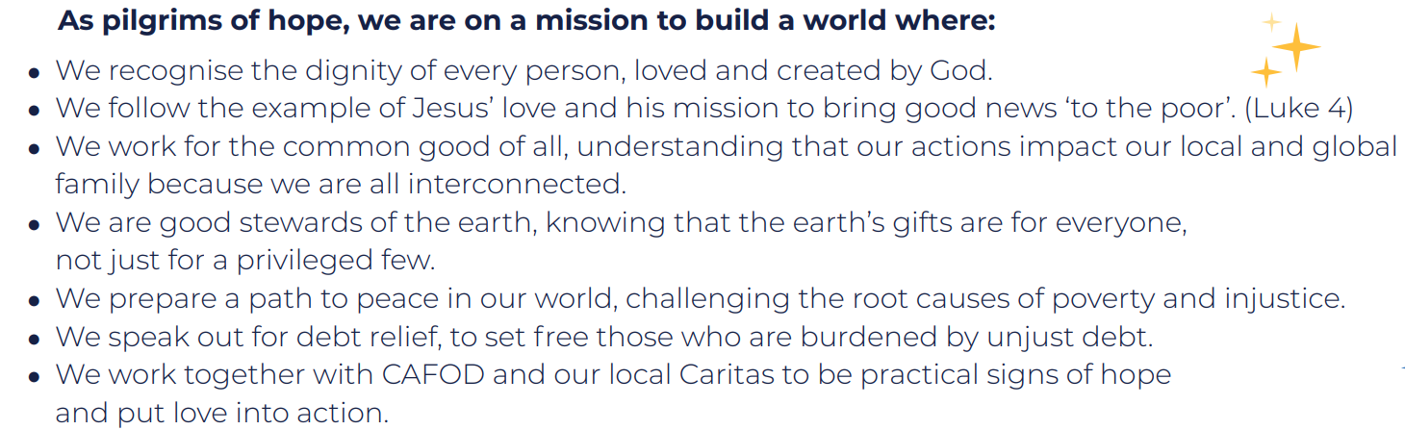

Live out CST
Part two: Expanding the vision of the first four lines. Can you find the direct links to CST principles?
Dignity
Solidarity
Option for the poor
The common good
Stewardship
Peace building
Distributive justice
Participation
You bring these principles to life already in your school.
Q: Are there areas that need greater focus, or deeper learning?
Q: How can you plan to embed CST for the long term?
Notes:
In making the Jubilee pledge, we promised to live out Catholic Social Teaching. It’s not too late to make your pledge and mark that on the Pledge Map! There are many ways you can live out the Jubilee Pledge and CST with CAFOD. Ideas can be found at cafod.org.uk/jubilee-schools/jubilee-pledge

Slide 6
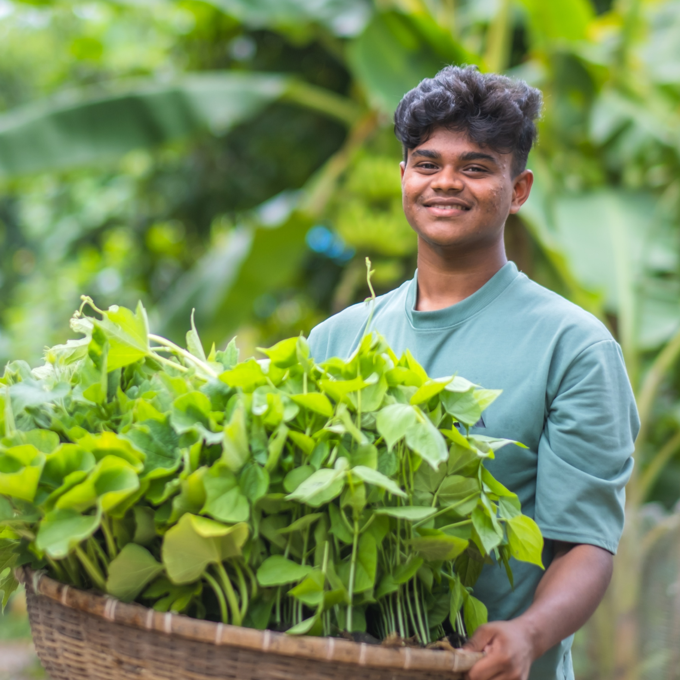
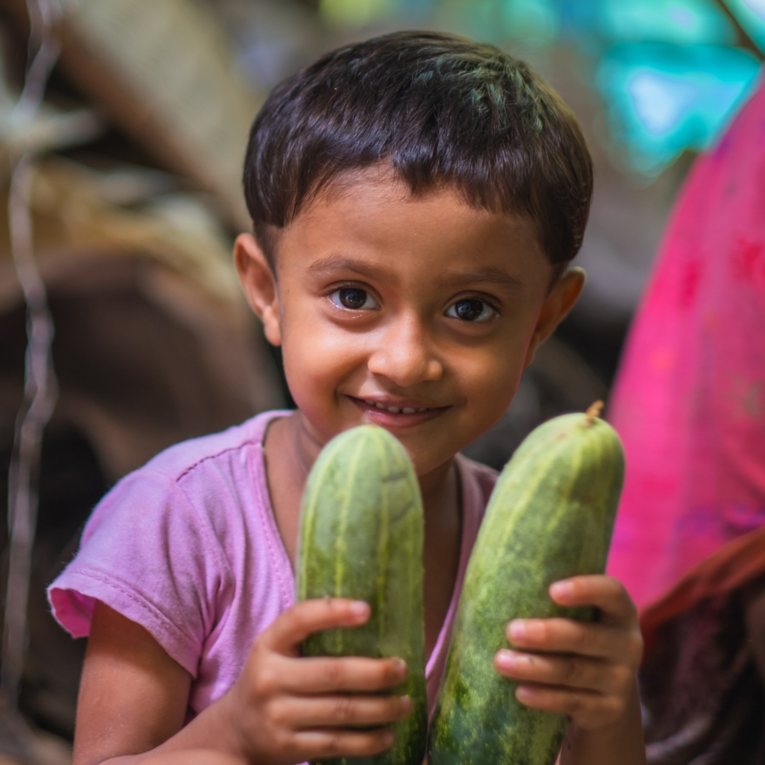
Lent 2026
Meet Bayezid and Zunayed, and visit their floating garden in Bangladesh!
Floating gardens allow the family to fulfil their food needs in times of unpredictable weather due to the climate crisis.
They float on the riverbeds which allows the water to drain rather than the plants getting water logged.
Watch love grow this Lent!
Online resources:
Lent film
Big Lent Walk film
School screensavers
Lent calendars: for primary and secondary.
Primary national assembly: Join online on 26 February!
Bangladesh photopack (Secondary)
Zunayed, Bangladesh
Bayezid, 16, Bangladesh
Notes:
Bayezid is the older boy (16) and Zunayed is the younger boy. The floating gardens allow the family to fulfil their food needs in times of unpredictable weather due to the climate crisis. They float on the riverbeds which allows the water to drain rather than the plants getting water logged.
In some parts of the world, there is too little rain. In Bangladesh, there is too much. The result is the same – seeds don't grow, plants die, families go hungry. With CAFOD’s help, communities in Bangladesh are building floating gardens that are immune to floods, allowing them to grow enough food to eat and sell, helping them make a living. This Lent, please consider taking part in the Big Lent Walk to raise funds for life-saving water. Our popular prayerful Lent calendars for children and young people can be found online.

Slide 7



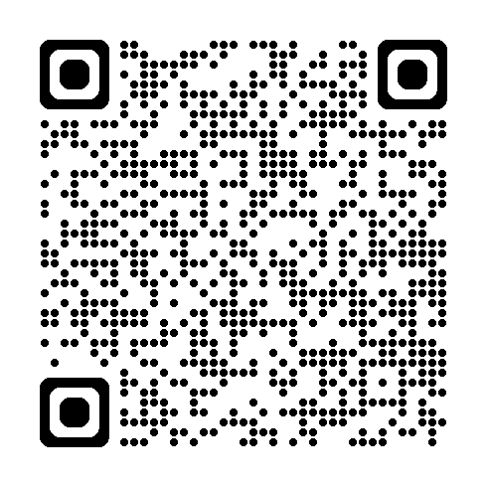

Year ahead: fundraising opportunities
27 February 2026: Lent Fast Day and Big Lent Walk
2 October 2026: Harvest Fast Day
Register to take part in the Big Lent Walk 2026:
cafod.org.uk/blwschools
Notes:
Your fundraising makes all the difference to our work, and is a great way of living out many of the principles of Catholic Social Teaching, such as distributive justice, participation, option for the poorest and most vulnerable, and solidarity. Thank you for all the ways in which you support the work of CAFOD.

Slide 8

Dilexi te
Coming soon: our new animation!
Dilexi te is Pope Leo’s first Apostolic Exhortation and is all about God's love for the most vulnerable and marginalised people in our society.
Notes:
Dilexi te is an Apostolic Exhortation and is all about God's love for the most vulnerable and marginalised people in our society. CAFOD’s new animation for children and young people will explore the message, and what it means for our schools today.

Slide 9

School visits
Primary:
  A better world needs all of us
  Getting to know our global neighbours and exploring CST.
Secondary:
  St Oscar Romero: Truth in the media
  A 50-minute workshop exploring truth in the media, inspired by the life and writings of St Oscar Romero. Students will construct a reel/news article on mining in El Salvador while assessing common pitfalls that lead to misinformation spreading.
Notes:
This term, CAFOD school visitors can run Y5 and Y6 workshops on the theme of “A better world needs all of us”. Our secondary workshop explores truth in the media, inspired by the life and writings of St Oscar Romero. Students will construct a reel/news article on mining in El Salvador while assessing common pitfalls that lead to misinformation spreading. Visits can be booked via your local CAFOD contact ([diocese] @ cafod.org.uk), or via schools@cafod.org.uk.

Slide 10


Slide 11

St Oscar Romero: truth in the media
Notes:
A 50-minute workshop exploring truth in the media, inspired by the life and writings of St Oscar Romero. Students will construct a reel/news article on mining in El Salvador while assessing common pitfalls that lead to misinformation spreading.

Slide 12

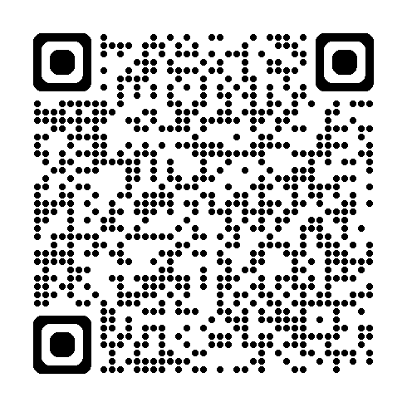
Campaign with CAFOD
Notes:
Although the Jubilee is over, the global debt crisis is not. Please continue to learn about the issues of debt justice. Campaigning with CAFOD is a great way to live out your Jubilee pledge.
https://cafod.org.uk/education/campaign-in-your-school/jubilee-debt-crisis-campaign-for-schools

Slide 13

cafod.org.uk/cpd
Notes:
Visit cafod.org.uk/cpd to find CPD resources giving an overview of Catholic Social Teaching. We will be adding new CPD resources throughout the year.

