Slide 1
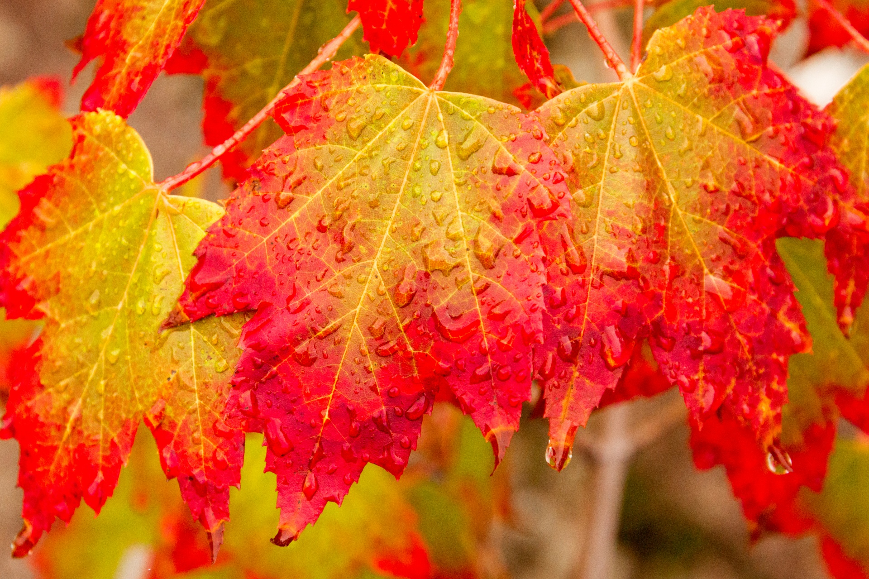
Resources
Autumn Term
2024

Slide 2
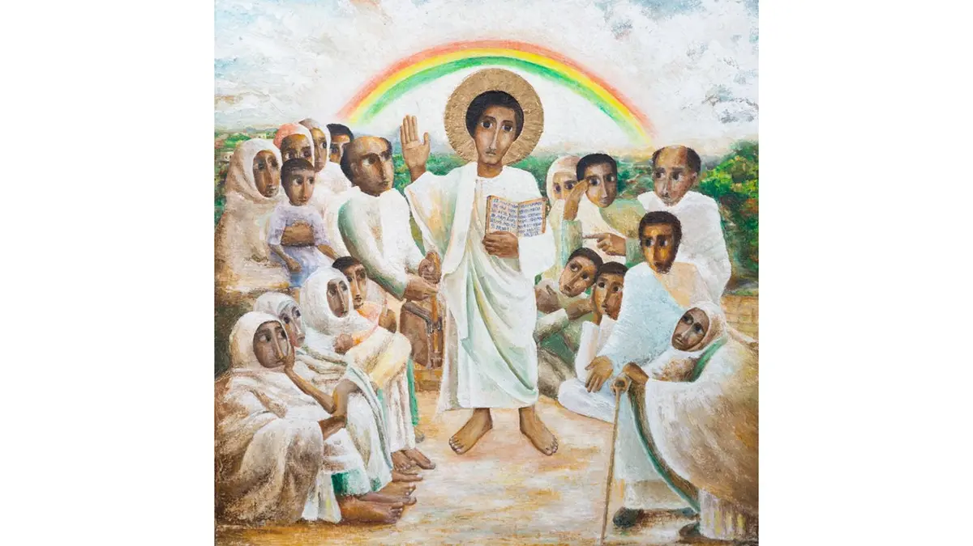
Jubilee Year 2025
Pilgrims of Hope
https://www.iubilaeum2025.va/en.html
https://youtu.be/yia25rOML2Q
https://cafod.org.uk/jubilee-schools
https://missiontogether.org.uk/jubilee-2025-pilgrims-of-hope/

Slide 3
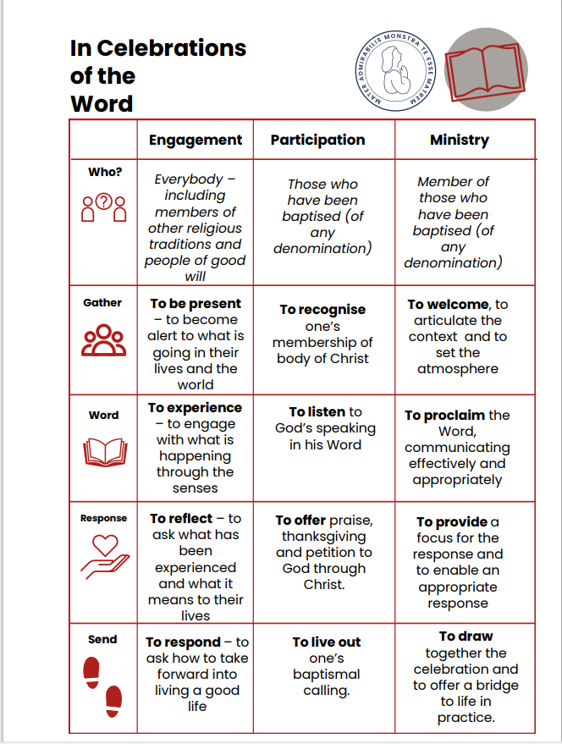
Prayer & Liturgy
Celebrations of the Word
Diocesan CPD Day
Thursday 7th November
Prayer & Liturgy
Led by Jo Boyce CJM Music
Loreto Centre Llandudno
https://rcaol.sharepoint.com/sites/PrimaryAdvisers/Shared%20Documents/CES%20Information/In%20Celebrations%20of%20the%20Word.pdf

Slide 4
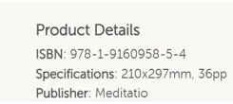
Prayer & Liturgy
Meditation
Christian Mindfulness Ideas for Kids | Children's Worship Bulletins Blog (childrensbulletins.com)
The Quiet Mind Project
Lancaster Diocese
https://www.lancaster-diocese-education.org.uk/app/uploads/2015/03/Quiet-Mind-25-4-14.pdf

Slide 5
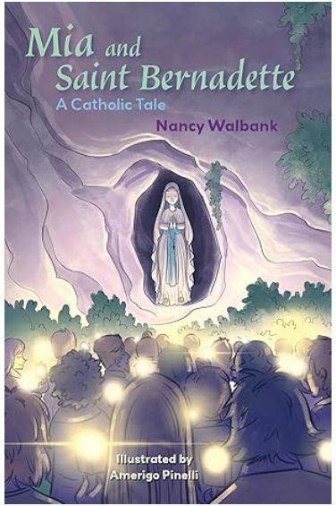
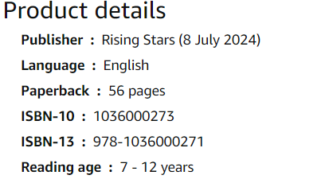
Saints
Available on Amazon £8.00

Slide 6
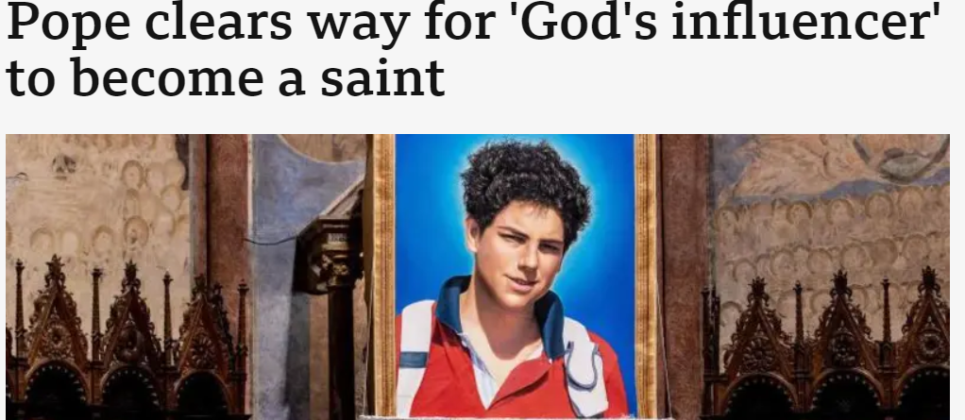
BBC News
May 2024
Carlo Acutis died in 2006, of leukemia, at the age of 15, meaning he would be the first millennial - a person born in the early 1980s to late 1990s - to be canonised.
https://www.catholicnewsagency.com/news/46048/who-was-carlo-acutis-a-cna-explainer

Slide 8
https://paxchristi.org.uk/peace-education/

