Slide 1
Lent and Lockdown

Slide 2
Look and Reflect
Lent gives us an opportunity to stand back and reflect on ourselves
Now more than ever in the midst of a pandemic do we need that time to step back.
To bring ourselves to God, to reflect on who we are, and who God wants us to be
Take a moment to look at your reflection…

Slide 3
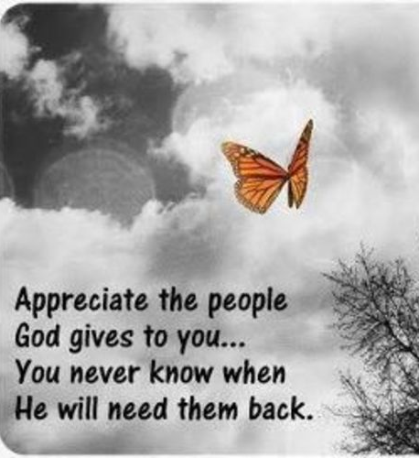
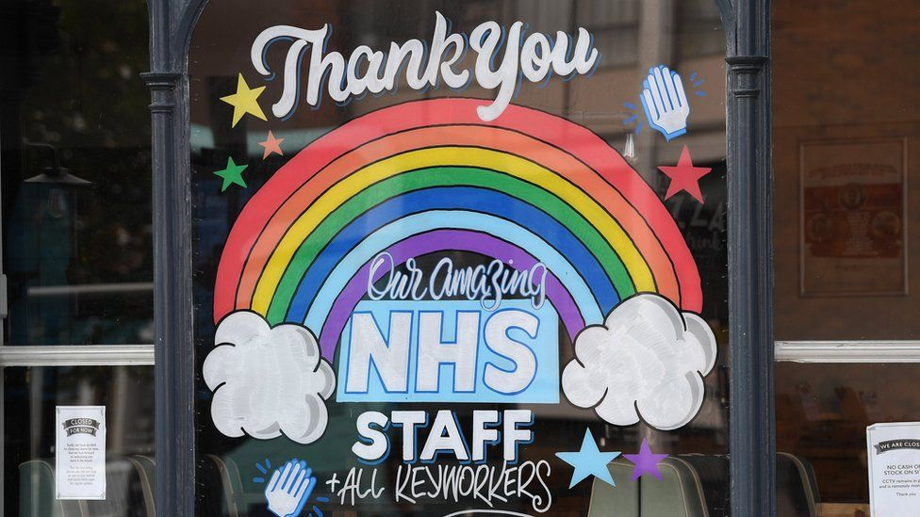
Appreciate
We sometimes forget to thank God for the people that we have been blessed with in our lives
The pandemic has taught us to appreciate those we love, the people we work with and our beautiful young people
We take a moment to thank God for those gifts.

Slide 4
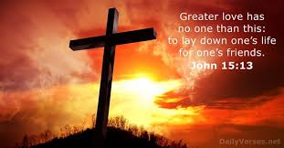
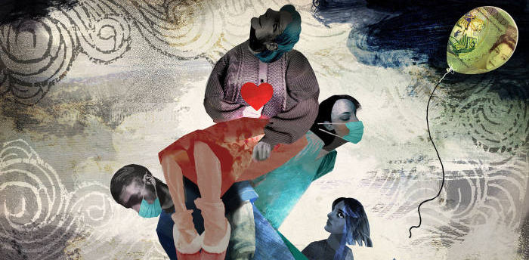
Sacrifice
Lent challenges us to make sacrifices for others
This year many have made sacrifices all year
We are more aware than ever before of Christ’s suffering as He walks alongside us in our suffering.

Slide 5
Time
Lent requires us to give more time to God…
and to others
“Love God with all your heart and all your mind and soul and love your neighbour as you love yourself”
This Lent we need to make time for ourselves in order to love our neighbour and love God.

Slide 6
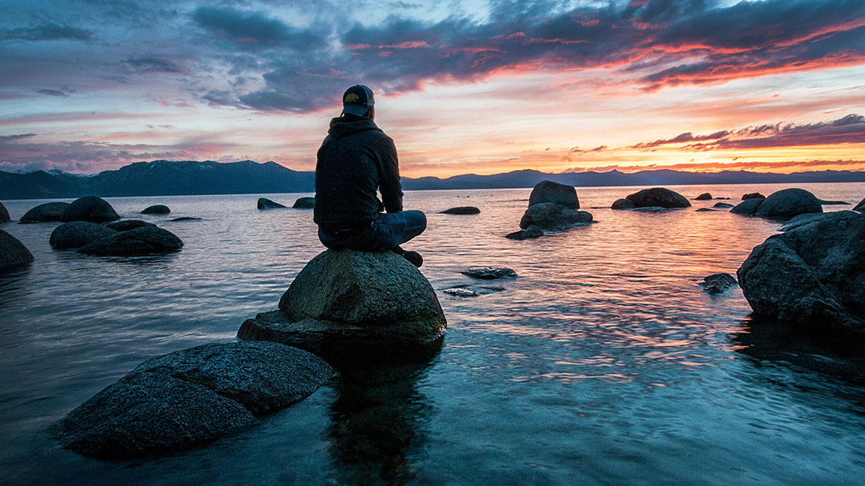
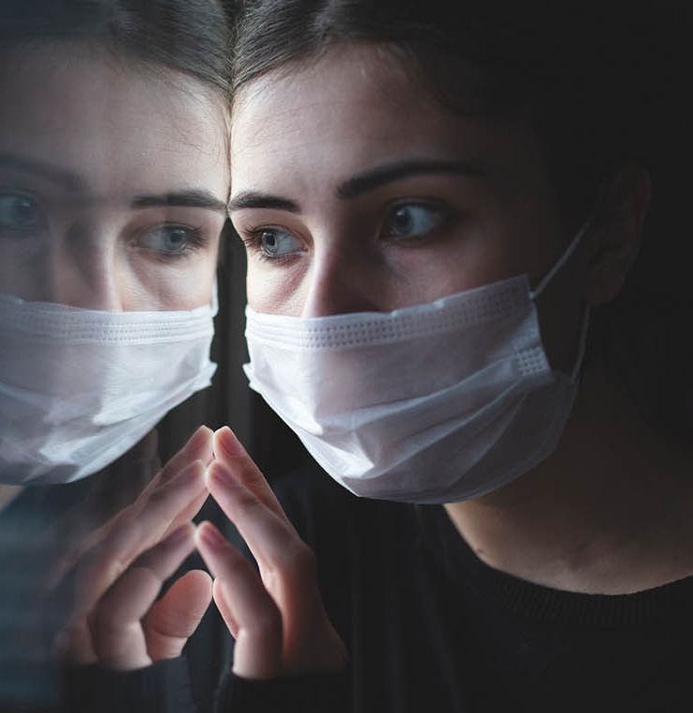
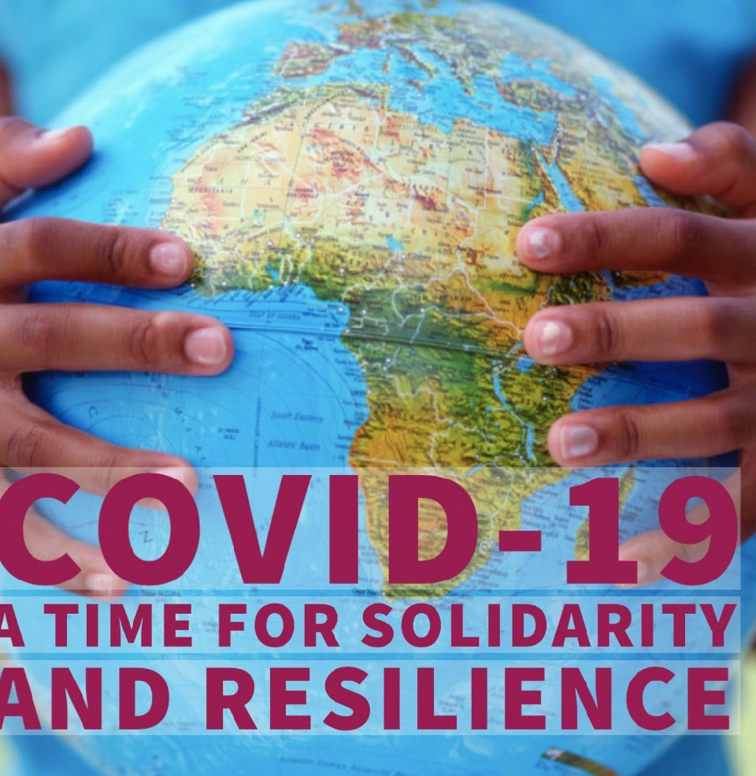
Solitude and Solidarity

Slide 7
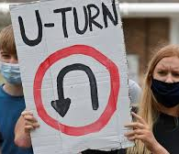
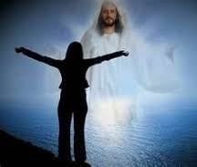
U Turns
During the pandemic we have seen a number of U turns
In Lent sometimes we need to make a U turn and make sure we are on the path that God intends us to be
Help us, Lord during Lent, to reject the temptations that take us in the wrong direction

Slide 8
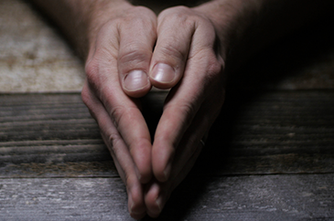
Prayer
Lent reminds us of the need for prayer in our lives
When facing the most significant challenges in His life Jesus took himself away in order to pray.
How many times have we asked our students to resolve their issues through communication with each other?
In the same way we need to keep the conversation going with God
This is what gives meaning and purpose to what we do.

Slide 9
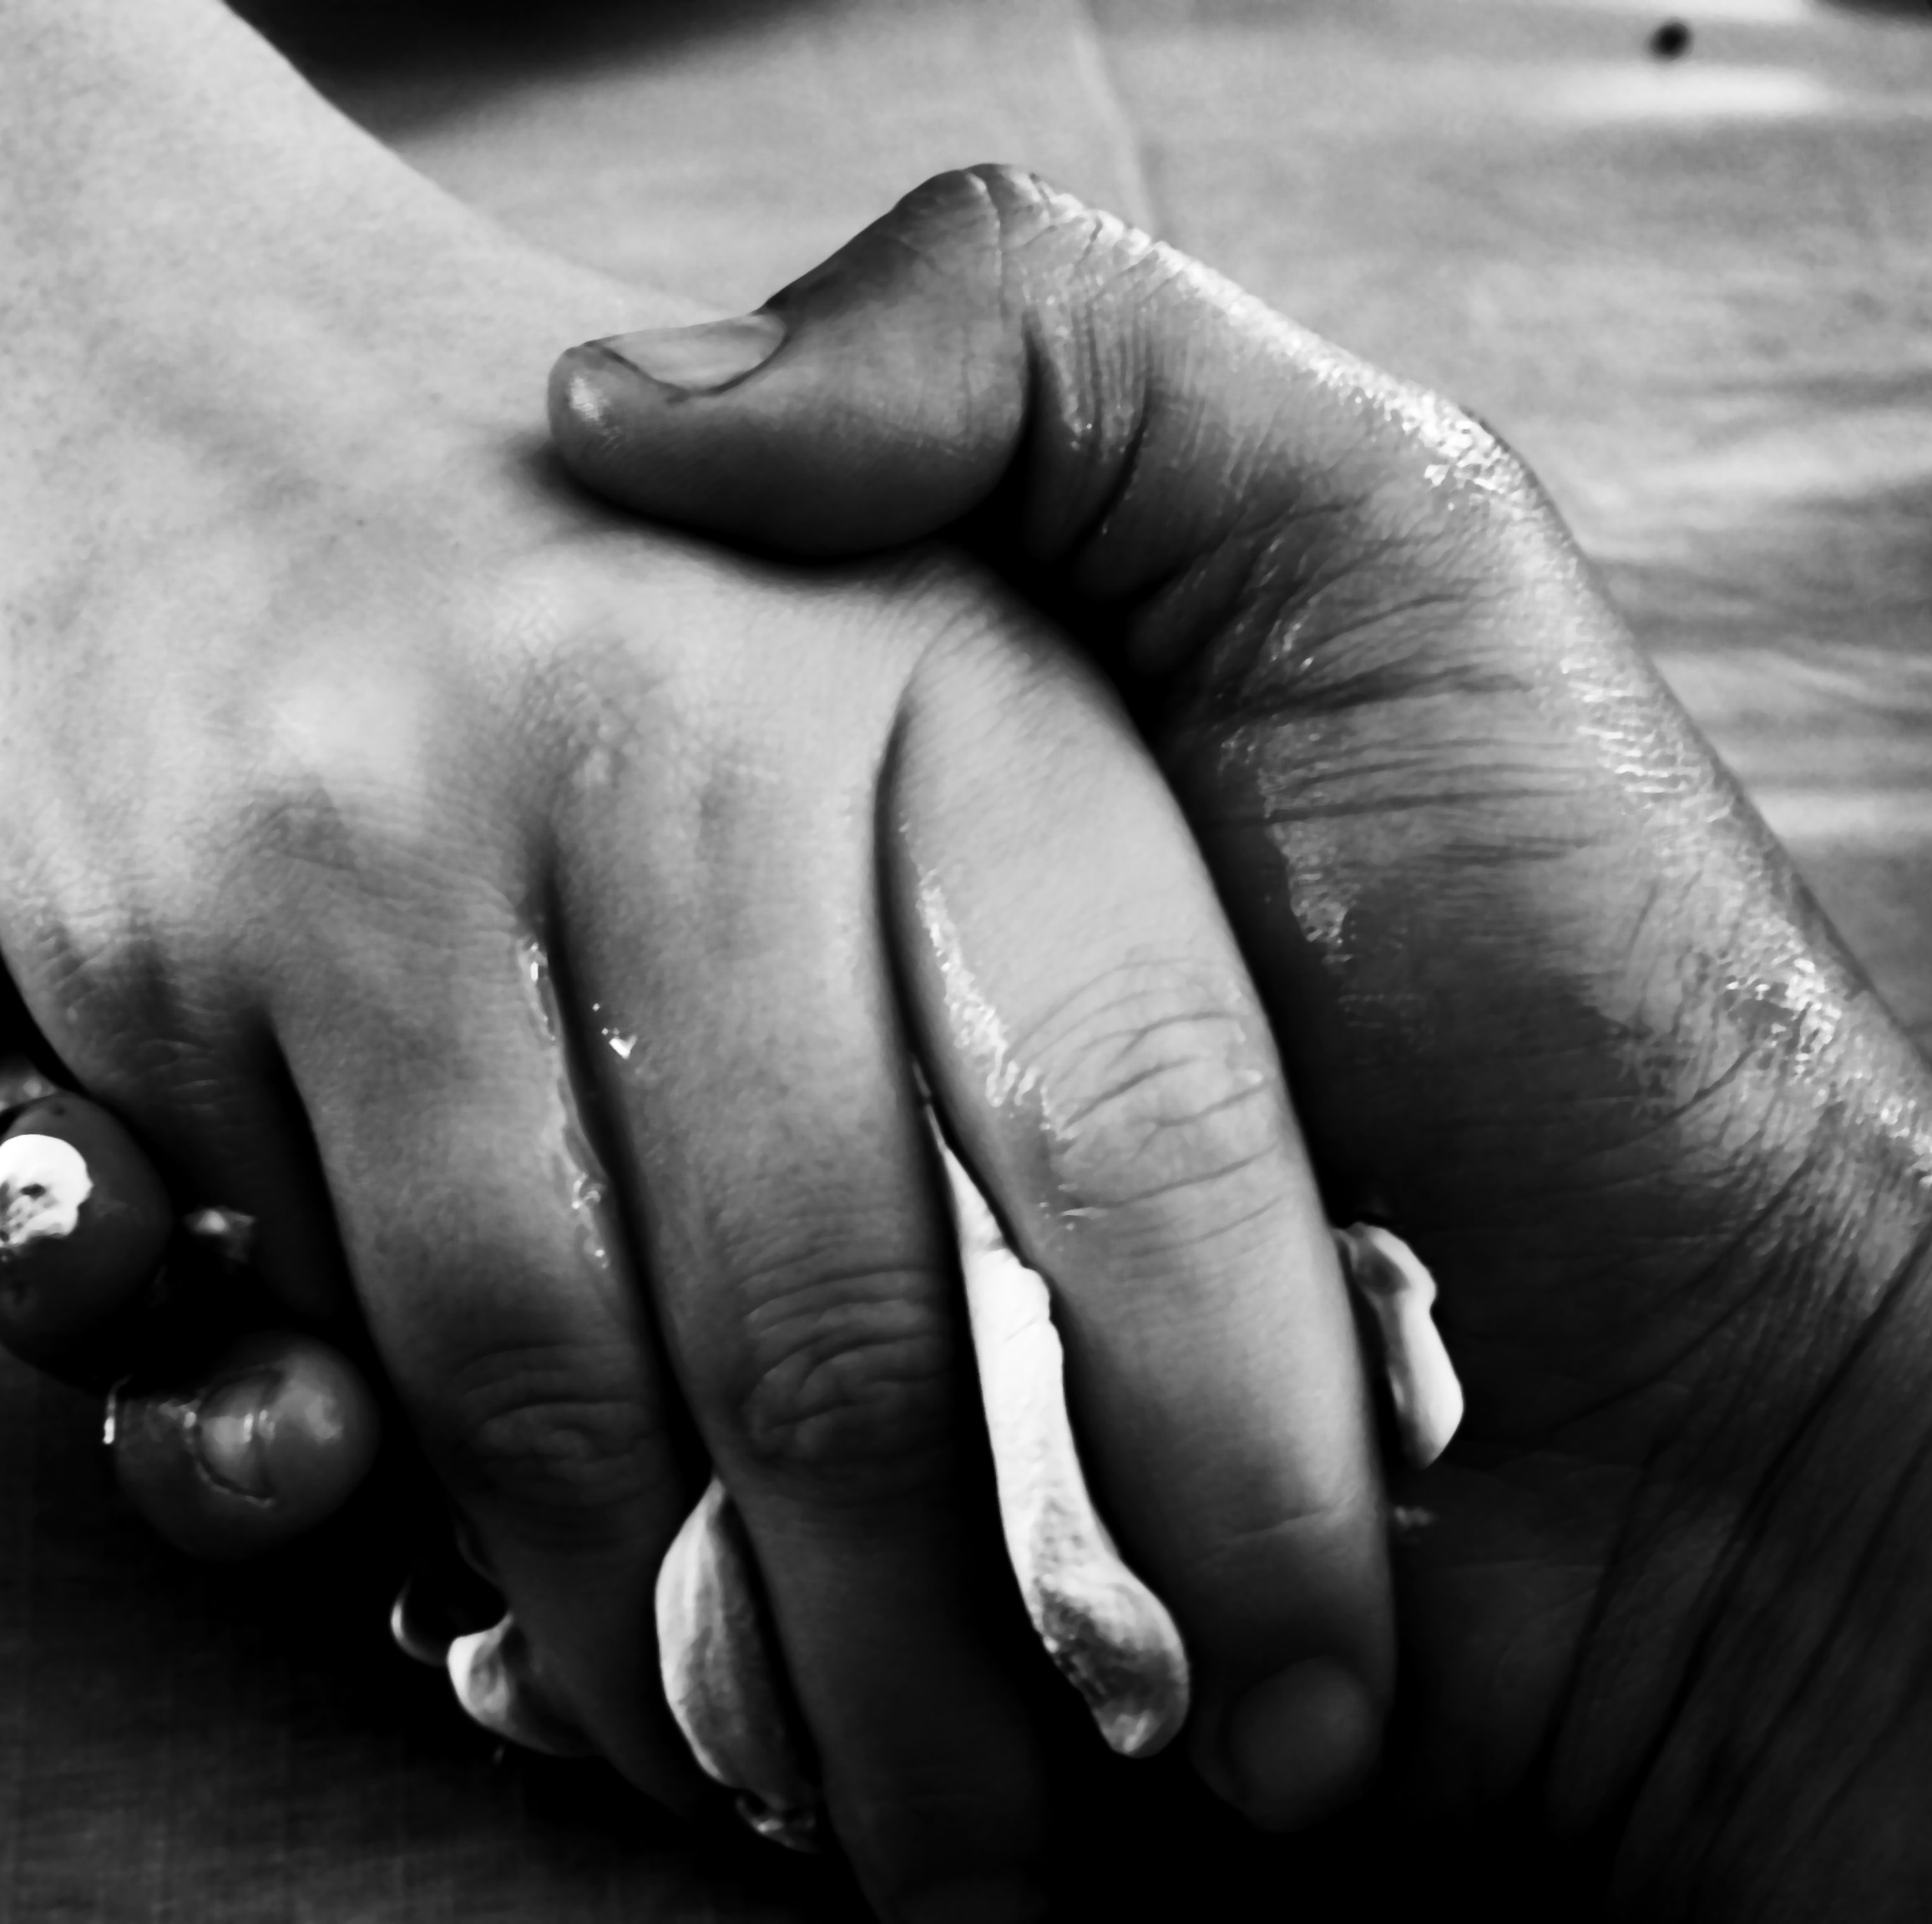
Penance
In Lent we are called to repent but also maybe to accept the things we cannot change
Reconciling ourselves to God is the process of acknowledging our human frailty
And facing our current challenges with Courage, Humility and Hope.

Slide 10
Endurance
Christ endured 40 days in the desert
We have endured nearly a year of this pandemic
In all that we have endured Christ has remained at the heart of our schools
And we look forward with joy to being back together again.

Slide 11
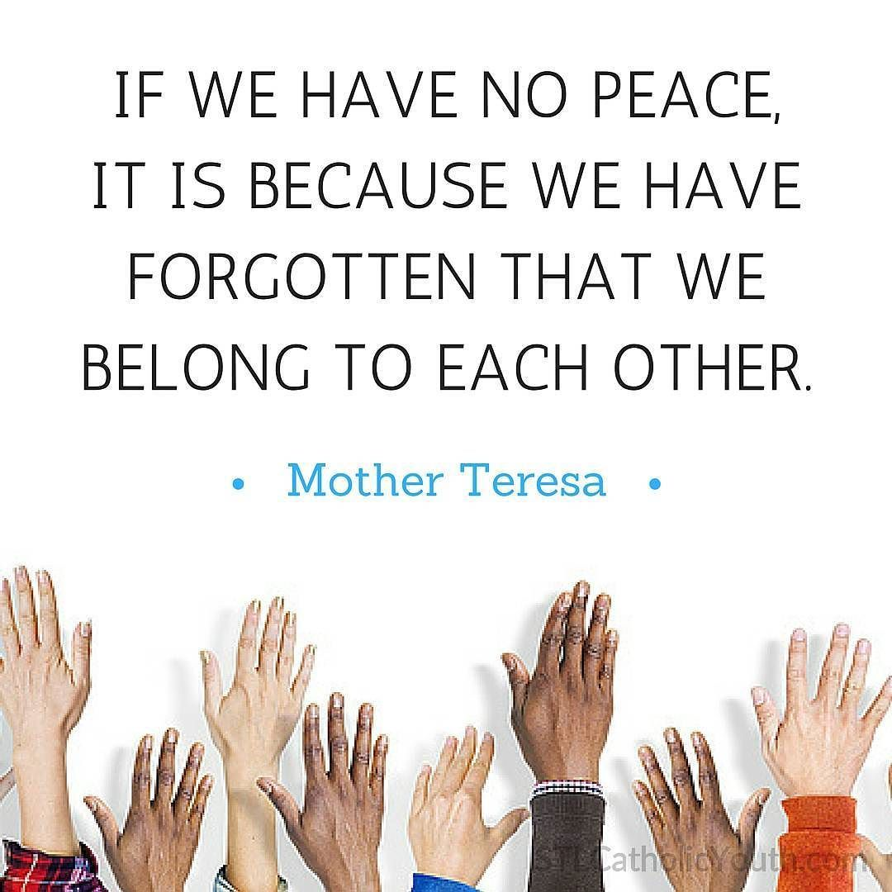
Relationships
We pray Lord that our family of diocesan schools continue to work together to fulfil the Bishop’s vision in making Christ known and loved in our communities.

Slide 12
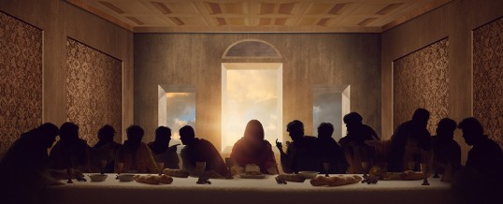
L
Look
Appreciate
Sacrifice
Time
Solidarity
U -Turns
Prayer
Penance
Endurance
Relationships
A
S
T
S
U
P
Where there is sacrifice and suffering…
P
E
R

Slide 13
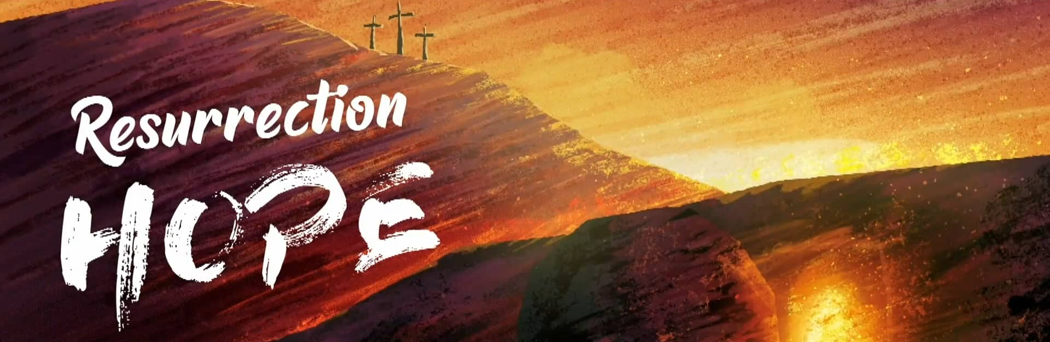
There is always hope

